Slide 1

from CVS to GIT

Slide 2
CVS issues
every commit is shared with your colleagues
when you break something, you **** your teammates

Slide 3
CVS issues
branching is not a quick task

Slide 4
CVS issues
someone can delete the whole project
i was there when it happened at GEC
« le vamos a cortar el dedo a alguien »
i read that email

Slide 5
CVS issues
everything takes time
creating a branch
creating a tag
showing the history
comparing with the past
so… it’s not common to use these features

Slide 6
whot’s CVS?
whot’s GIT?

Slide 7
whot’s CVS?
CVS server
your teammate
another teammate
a visual designer
you

Slide 8
whot’s GIT?
your teammate
you
a visual designer
another teammate

Slide 9
whot’s GIT?
GIT «server»
your teammate
another teammate
a visual designer
you

Slide 10
so… differences?
CVS
GIT
commit goes to server
branch goes to server
tag goes to server
problems go to server
the data is in several places
you need internet
commit goes to localhost
branch goes to localhost
tag goes to localhost
problems go to localhost
whole history is in the .git file
you don’t need internet

Slide 11
GIT glossary
commit
A single point in the Git history. The entire history of a project is represented as a set of interrelated commits.
https://git-scm.com/docs/gitglossary

Slide 12
GIT glossary
branch
An active line of development.
Your working tree is associated with just one branch.
https://git-scm.com/docs/gitglossary

Slide 13
GIT glossary
tag
A tag is most typically used to mark a particular point in the commit ancestry chain.
https://git-scm.com/docs/gitglossary

Slide 14
GIT glossary
merge
To bring the contents of another branch into the current branch. Merging is performed by an automatic process that identifies changes made since the branches diverged, and then applies all those changes together. In cases where changes conflict, manual intervention may be required to complete the merge.
https://git-scm.com/docs/gitglossary

Slide 15
let’s play!

Slide 16
GIT commands
setup your user
git config --global user.name "Roc Boronat"
git config --global user.email roc@fewlaps.com
https://git-scm.com/book/id/v2/Getting-Started-First-Time-Git-Setup

Slide 17
GIT commands
check your configuration
git config --list
https://git-scm.com/book/id/v2/Getting-Started-First-Time-Git-Setup

Slide 18
GIT commands
help!
git help commit
https://git-scm.com/book/id/v2/Getting-Started-Getting-Help

Slide 19
GIT commands
create a repository
git init
https://git-scm.com/book/id/v2/Git-Basics-Getting-a-Git-Repository

Slide 20
GIT commands
add files
git add Main.java
git add *.java
git add *.java
https://git-scm.com/book/id/v2/Git-Basics-Getting-a-Git-Repository

Slide 21
GIT commands
commit changes
git commit // will open vim
git commit –m "your message«
git commit –a // to also do an add
https://git-scm.com/book/id/v2/Git-Basics-Getting-a-Git-Repository

Slide 22
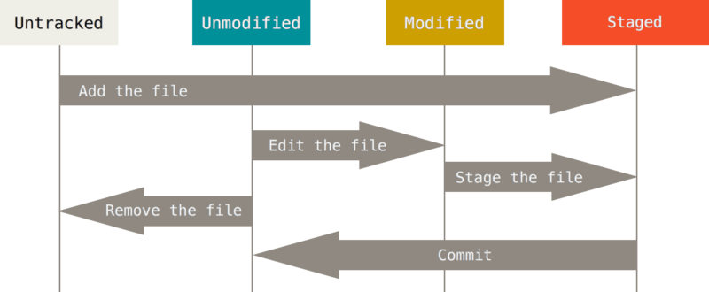
GIT commands
https://git-scm.com/book/id/v2/Git-Basics-Recording-Changes-to-the-Repository

Slide 23
GIT commands
status of the repo
git status
git status -s
git status -short
https://git-scm.com/book/id/v2/Git-Basics-Getting-a-Git-Repository

Slide 24
GIT commands
commit history
git log
https://git-scm.com/book/id/v2/Git-Basics-Viewing-the-Commit-History

Slide 25
GIT glossary
remote repository
A repository which is used to track the same project but resides somewhere else.
https://git-scm.com/docs/gitglossary

Slide 26
GIT commands
add a remote
git remote add [shortname] [url]
"origin" is the shortname of the default remote
https://git-scm.com/book/id/v2/Git-Basics-Working-with-Remotes

Slide 27
GIT glossary
push
To put local objects into the remote object database
https://git-scm.com/docs/gitglossary

Slide 28
GIT commands
push your changes
git push [remote] [branch]
https://git-scm.com/book/id/v2/Git-Basics-Working-with-Remotes

Slide 29
GIT glossary
pull
To fetch a branch and merge it.
https://git-scm.com/docs/gitglossary

Slide 30
GIT commands
pull changes from remote
git pull [remote] [branch]
https://git-scm.com/book/id/v2/Git-Basics-Working-with-Remotes

Slide 31

clone this presentation
git clone https://github.com/rocboronat/from-cvs-to-git

Slide 32
and squash it
git rebase -i HEAD~3

Slide 33
questions?
git help beers

